Slide 1
_{Assignment 3}
Spray characteristics under multiple injection strategies of biofuels
_{ANANT KUMAR NAYAK}
210129
Department of Mechanical Engineering
Indian Institute of Technology Kanpur, Kanpur

Slide 2
Introduction
Spray characteristics play a significant role in engine performance, emission and combustion characteristics.
The biofuels have different fuel properties such as viscosity, surface tension, cetane number, density and calorific value which influence spray characteristics of biofuels.
These properties affect the atomization of fuels which lead to the incomplete combustion of fuel.
There are two class of spray characteristics which are macroscopic and microscopic spray characteristics.
Macroscopic spray characteristics deals with the large scale parameters such as penetration length, spray cone angle, and radial width.
Microscopic spray characteristics deals with small scale parameters such as spray droplet diameter, Sauter Mean Diameter (SMD), spray droplet velocity.
Both characteristics have different measuring techniques such as Particle Image Velocimetry (PIV), Phase Doppler Particle Anemometry (PDPA).

Slide 3
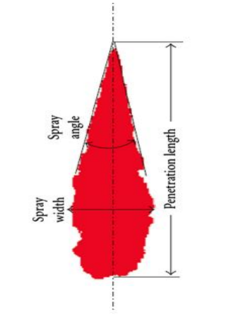
Macroscopic Spray Characteristics
Macroscopic characteristics deals with the large scale parameters such as spray penetration length, spray cone angle and spray radial width.
Spray penetration length is the maximum length from injector nozzle to the farthest point on the spray plume.
Larger penetration length of spray lead to wall wetting of cylinder which can lead to wear and tear in an engine whereas shorter penetration length can cause ineffective air-fuel mixture.
Spray cone angle is defined as the measure of spread of spray from
the exit of the injector nozzle.
Spray radial width is maximum horizontal distance of spray plume.
It also shows how much spray is expand in the horizontal direction.
As shown in the figure 1 which give the clear understanding.
Fig. 1. Measurement of macroscopic characteristics
Bohl, T., Tian, G., Smallbone, A. and Roskilly, A.P., 2017. Macroscopic spray characteristics of next-generation bio-derived diesel fuels in comparison to mineral diesel. Applied Energy, 186, pp.562-573.

Slide 4
Measurement technique of macroscopic characteristics
To measure the macroscopic spray characteristics experiments were conducted at high pressure and high temperature.
In this experiment there is one chamber which is filled with nitrogen at medium pressure and high temperature. This chamber is generally known as constant volume combustion chamber (CVCC) or constant volume vessel (CVV).
On this chamber solenoid injector is placed normally to it which is connected to the common rail injection system.
The fuel injector system injects the fuel at various FIPs and this spray plume is illuminated by the white light.
The fuel injection is containing a high pressure fuel pump which have highly pressurized fuel of 1800 bar.
There is a high speed camera which capture the clear images of spray and then these images is further processed by image processing technique.

Slide 5
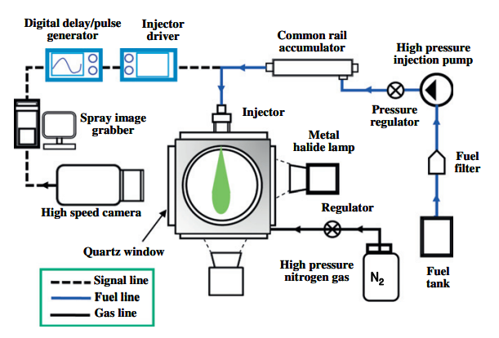
As shown in the figure 2 which clearly shows that how each and every components are connected to each other which help to understand the basic principle of experiment.
After obtaining all the images at desired physical condition. Then different sets of images are created.
Then the MATLAB code is generated which further process the image.
This MATLAB code converted RGB image to binary image. This binary image help to measure the macroscopic
Fig.2 . Experimental setup of constant volume vessels
parameters which we have discuss in the upper slide that is spray penetration length, cone
angle and radial width.
Park, S.H., Yoon, S.H. and Lee, C.S., 2011. Effects of multiple-injection strategies on overall spray behavior, combustion, and emissions reduction characteristics of biodiesel fuel. Applied Energy, 88(1), pp.88-98.

Slide 6
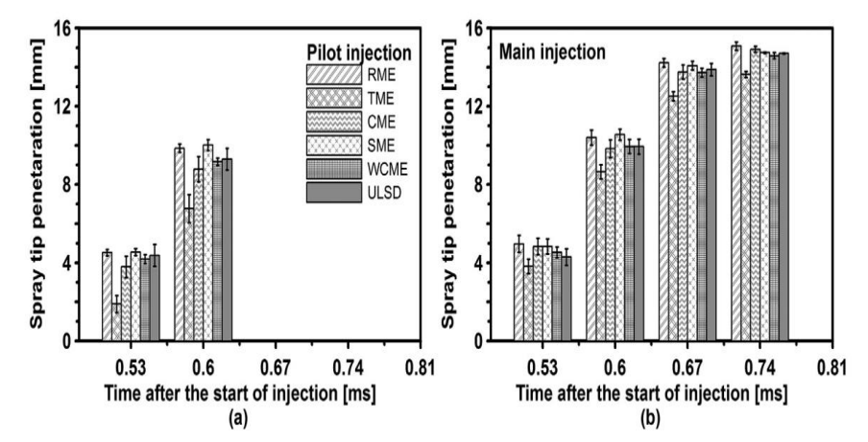
Effect of injection strategies on macroscopic characteristics
In this section we see the effect of pilot injection and main injection on penetration length of different biofuels.
Pilot injection is defined as the injecting a small amount of fuel before the main injection event of fuel.
Main injection is defined as injecting the bulk of fuel at one time only. In this there is not steps to inject the fuel in combustion chamber.
As shown in figure 3 each vertical bar shows the spray penetration length of different bio fuels such as RME, TME, CME, SME, WCME and ULSD.
Fig.3 . Spray penetration length at different timing for pilot and main injection
Oscar A. de la Garza, S. Martínez-Martínez, Madan Mohan Avulapati, Radboud Pos, Thanos Megaritis, Lionel Ganippa, 2021. Biofuels, and its spray interactions under pilot-main injection strategy. Energy, 219, pp 110-464.

Slide 7
Figure 3a shows the comparison of penetration length of pilot injection at 0.53ms and 0.60ms whereas fig 3b shows the comparison of penetration length at main injection strategy.
The ULSD biofuels taken as a reference as shown in figure penetration length of RME and SME are both comparable to each other whereas slightly longer than ULSD>
TME has the lowest spray penetration length among all the biofuels. TME has lowest penetration length in both pilot as well as main injection.
The difference in the TME and ULSD as well as all other biofuels is due to the differences in the flow properties of fuel through nozzle hole caused by its high viscosity.
This viscosity causes the delay in the early start of injection because it affects nozzle needle move during the initial opening.
Due to this effect TME is decelerate its injection speed and result in small penetration length in pilot injection.
Whereas in main injection needle is fully lifted and TME spreads up very easily due to plenty of time.

Slide 8
Microscopic spray characteristics
Microscopic spray characteristics mainly deals with small scale region of spray such as droplet diameter, velocity distribution, radial and axial component of velocity.
It mainly describe the spray droplet size, droplet number density and droplet size distribution. Spray droplet can be measured by various diameter such as volume mean diameter, arithmetic mean diameter and Sauter Mean Diameter (SMD).
Volume mean diameter is defined as the diameter of droplet that gives the volume of complete sample, if multiplied by the total number of droplets.
Arithmetic mean diameter is defined as the average of all the diameter of spray droplet in a plume.
Sauter Mean Diameter (SMD) is defined as the average measure of particle size. It is the diameter that has same volume/surface area ratio as particle of interest.
These parameters are essential to know the effectiveness and efficiency of a spray atomization. Atomization affects the ignition quality and combustion efficiency of fuel.
It is crucial to understand the microscopic characteristics of a fuel in order to know the effectiveness and efficiency of fuel atomization.

Slide 9
Measurement technique of microscopic characteristics
Similar to macroscopic experiment this experiment is also consist of constant volume spray chamber (CVSC) in which non reacting gases are filled.
This CVSC consist of seven flanges out of which five flanges has quartz window and remaining two have metallic window.
This CVSC experiment consists of fuel injection system, CVSC and Phase Doppler interferometry (PDI). Each of this system consist of several component.
This PDI instrument helps to measure the droplet size, velocity distribution and also measure the drop size and component of velocity.
In PDI system the Artium 3D system consists of two transmitters, one receiver, three signal analysers and a computer.
These two transmitters delivered the six-laser beam, which is intersected in point called probe volume.
A second pair of laser beams disposed orthogonal to the first pair is used to measure the orthogonal velocity component.

Slide 10
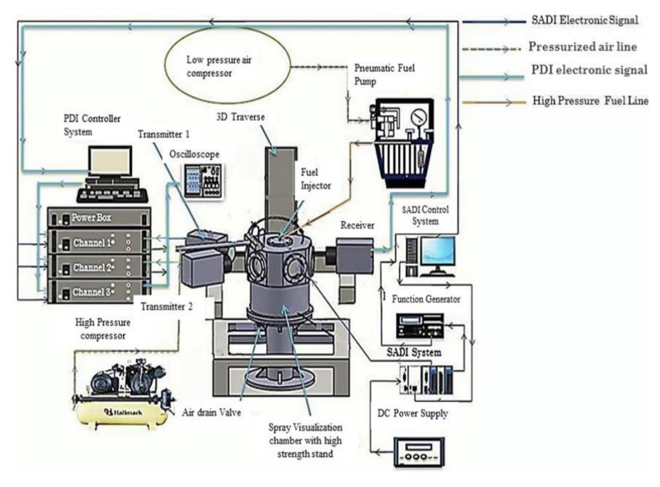
As shown in the figure 4 it is clear that how each component of experiment connected to each other.
In this experiment, there are four laser beams of different colors which are converge at one spot in CVSC.
This convergence is done on the quartz window, which is transparent to these laser beams and at the same time another quartz window is setup to receive the signal by PDI receiver.
Fig.4. Schematics of CVSC for microscopic characteristics measurement
There is one high speed camera which is used to visualize the spray evolution. It is used to see what actually happening in the setup.
The minimum frame rate of 5400 fps at maximum resolution and minimum resolution of 675000 fps which means that this camera capture the images very quickly.
Nikhil Sharma, William D. Bachalo, Avinash Kumar Agarwal; Spray droplet size distribution and droplet velocity measurements in a firing optical engine. Physics of Fluids 1 February 2020; 32 (2): 023304.

Slide 11
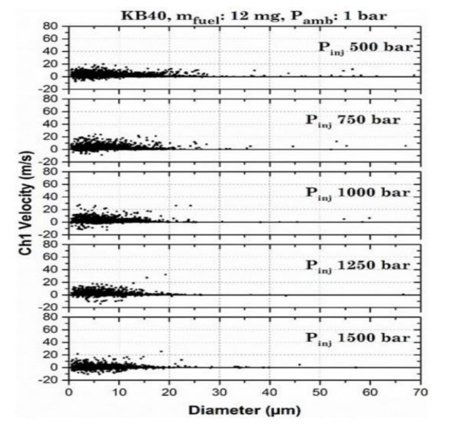
Effect of FIPs on the microscopic parameters of biofuel
As shown in the figure 5 it represents the scatter plot of spray droplet size in X axis and component of velocity in Y axis.
This figure indicates the diameter to velocity correlation of spray droplet of blend Karanja biodiesel of 40% blend (KB40) at different FIPs.
When the spray start coming out from the nozzle it can be observed that outer droplets break up faster in comparison to inner droplet part due to rapid movement of outer periphery of fuel spray.
This figure also indicates that by increasing fuel injection pressure (FIP) increases the droplet peak
Fig.5 . Scatter plot of droplet diameter and axial velocity
velocity. But at 1500 bar peak velocity is observed to lower due to the poor atomization.
Peak velocity distribution of smaller droplet size was higher for mineral diesel in compared to blend biodiesel (KB20 and KB40).
Gupta, J.G. and Agarwal, A.K., 2016. Macroscopic and microscopic spray characteristics of diesel and Karanja biodiesel blends (No. 2016-01-0869). SAE Technical Paper.

Slide 12
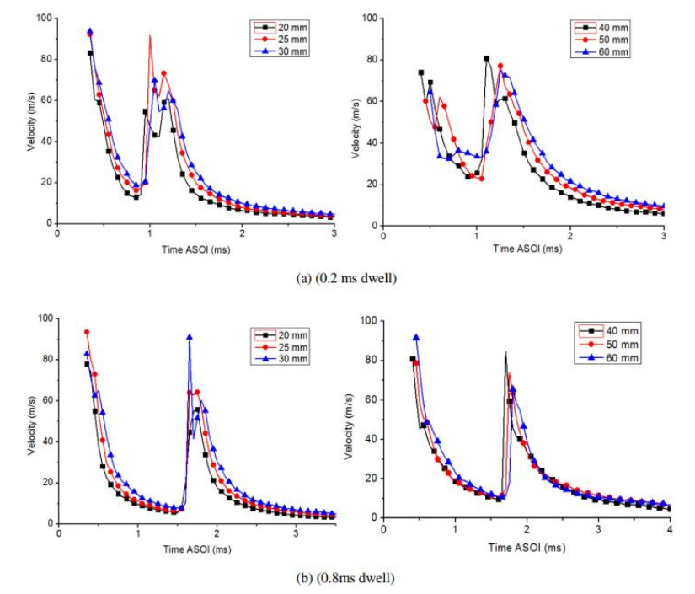
Effect of split injection in mean velocity of spray droplet
So far we have discussed the effect of FIP in spray droplet size and velocity distribution. Now we see the effect of split injection technique in the mean velocity of spray droplet with different dwell. Dwell is the time interval between two consecutive injection of fuel.
As shown in figure 6 which indicates the mean velocity at different dwells (0.2ms and 0.8ms) at 60Mpa injection pressure.
Initially the velocity is sharply decreasing and then it start quickly rising just before second injection takes place.
The peak velocity at second injection for 0.8ms dwell is lower than the peak velocity of first injection whereas for 0.2ms dwell the result is opposite.
Fig.6 . Mean velocity at various position of different dwells
Wang, Z., Xu, H., Jiang, C. and Wyszynski, M.L., 2016. Experimental study on microscopic and macroscopic characteristics of diesel spray with split injection. Fuel, 174, pp.140-152.

Slide 13
The main reason behind this is the dwell timing. As the injection duration decreases, the high velocity phase during the second injection event become longer.
This happens because the shorter dwell time cause the injector to open for long period of time during the second injection, due to which more fuel being injected at a high velocity.
Hence, the shorter pauses between injections result in the injector to open for long time period and causing more fuel to inject at a very high speed.

Slide 14
Conclusion
The spray characteristics of fuel have a great effect on the combustion and ignition quality of a fuel due to which desired emission norms can be reached.
By understanding the spray behavior help to give the possible solution to reduce fuel consumption and pollution emission level.
Both the microscopic and macroscopic spray characteristics plays an crucial role to give efficient air-fuel mixer which affect the quality of combustion.
The atomization of fuel spray depends on the properties such as viscosity, vaporization, enthalpy and surface tension. These properties affect the atomization of fuel which lead to inefficient air-fuel mixer.
Multiple injection strategies such as pilot, main and split injection have a great influence in the engine performance and combustion quality of fuel.
These injection techniques affect the spray characteristics of a fuel and depending on the need from the engine favorable injection technique were used in the engine for better spray characteristics.

Slide 15
Thanks

